Slide 1

BULLET: | O RING BATCH INSPECTION SAMPLING PLAN
DETAIL: | NORMAL SINGLE SAMPLING PLAN FOR STANDARD BATCHES (and new combination batches from a Single Cavity MOULD)
BATCH SIZE | SAMPLE SIZE | REACTION SAMPLE SIZE
2 - 15 | 2 | (4)*
16 – 50 | 3 | (6)
51 – 150 | 5 | (10)
151 – 500 | 8 | (16)
501 – 3200 | 13 | (20)
3201 – 35000 | 20 | (30)
35001 – 500000 | 32 | (40)
500001 < | 50 | (50)
APPENDIX OF QPD79 – REV 5

Slide 2
BULLET: | O RING ‘NEW COMBINATION’ INSPECTION SAMPLING PLAN
DETAIL: | TIGHTENED SAMPLING PLAN FOR ‘NEW COMBINATION’ BATCHES OF MULTI CAVITY MOULDS
BATCH SIZE | TIGHTENED SAMPLE SIZE FOR NEW COMBINATION INSPECTION
3 - 8 | 4*
9 – 15 | 6
16 – 25 | 8
26 - 40 | 10
41 - 65 | 15
66 - 110 | 20
111 -180 | 25
181 - 300 | 30
301 - 500 | 35
501 - 800 | 40
801 - 1300 | 50
1301 - 3200 | 100
APPENDIX OF QPD79 – REV 5

Slide 3
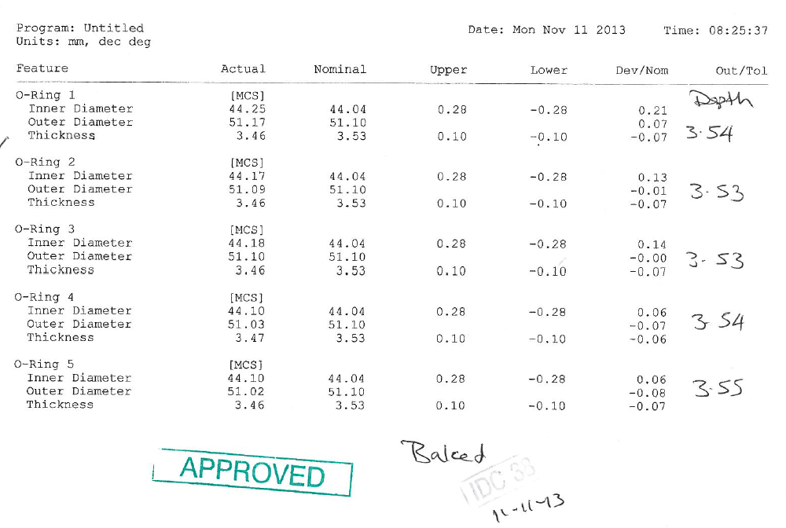
BULLET: | O RING ‘NEW COMBINATION’ INSPECTION MICRO VU REPORT
DETAIL: | Micro Vu sheets are filled out with depth measurements, approved stamp and IDC stamp and date
DEPTH IS TO BE CHECKED IN 4 PLACES AROUND THE O RING
APPENDIX OF QPD79 – REV 5

